Slide 1
Set Theory
Chapter 3

Slide 2
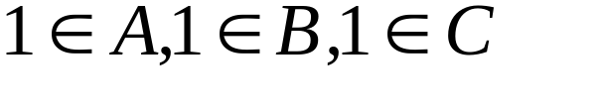
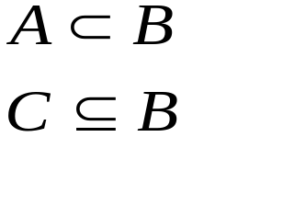
Chapter 3 Set Theory
3.1 Sets and Subsets
A well-defined collection of objects
(the set of outstanding people, outstanding is very subjective)
finite sets, infinite sets, cardinality of a set, subset
A={1,3,5,7,9}
B={x|x is odd}
C={1,3,5,7,9,...}
cardinality of A=5 (|A|=5)
A is a proper subset of B.
C is a subset of B.

Slide 3
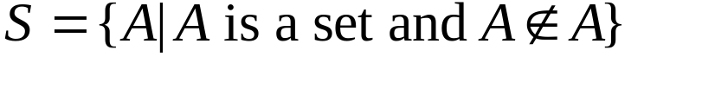
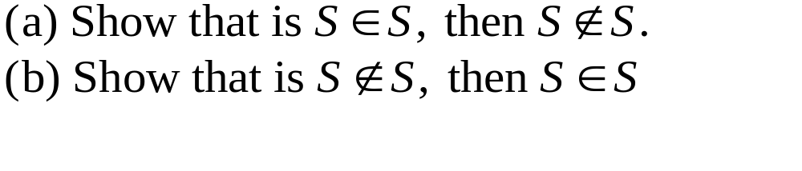
Chapter 3 Set Theory
3.1 Sets and Subsets
Russell's Paradox
Principia Mathematica by Russel and Whitehead

Slide 4
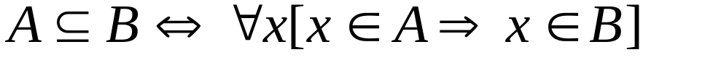
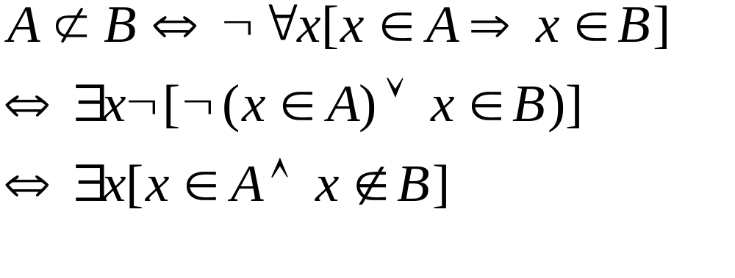
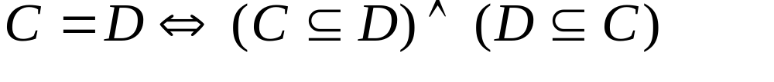
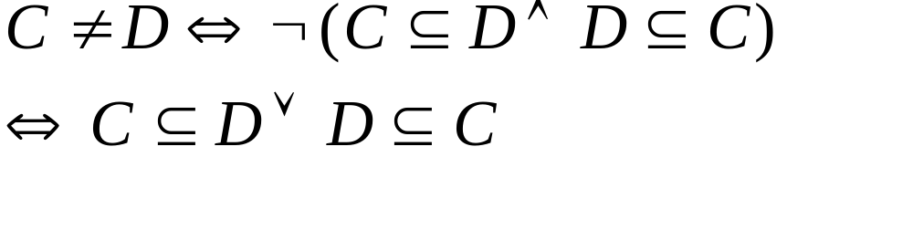
Chapter 3 Set Theory
3.1 Sets and Subsets
subsets
set equality

Slide 5
Chapter 3 Set Theory
3.1 Sets and Subsets
null set or empty set : {}, φ
universal set, universe: U
power set of A: the set of all subsets of A
A={1,2}, P(A)={φ, {1}, {2}, {1,2}}
If |A|=n, then |P(A)|=2^{n}.

Slide 6
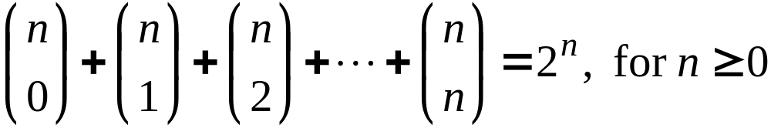
Chapter 3 Set Theory
3.1 Sets and Subsets
If |A|=n, then |P(A)|=2^{n}.
For any finite set A with |A|=n≥0, there are C(n,k) subsets of size k.
Counting the subsets of A according to the number, k, of elements in a subset, we have the combinatorial identity

Slide 7
Chapter 3 Set Theory
3.1 Sets and Subsets
Ex. 3.9
Number of nonreturn-Manhattan paths between
two points with integer coordinated
From (2,1) to (7,4): 3 Ups, 5 Rights
R,U,R,R,U,R,R,U
8!/(5!3!)=56
permutation
8 steps, select 3 steps to be Up
{1,2,3,4,5,6,7,8}, a 3 element subset represents a way,
for example, {1,3,7} means steps 1, 3, and 7 are up.
the number of 3 element subsets=C(8,3)=8!/(5!3!)=56

Slide 8
Chapter 3 Set Theory
3.1 Sets and Subsets
Ex. 3.10 The number of compositions of an positive integer
4=3+1=1+3=2+2=2+1+1=1+2+1=1+1+2=1+1+1+1
4 has 8 compositions. (4 has 5 partitions.)
Now, we use the idea of subset to solve this problem.
Consider 4=1+1+1+1
The uses or not-uses of
these signs determine
compositions.
1st plus
sign
2nd plus
sign
3rd plus
sign
compositions=The number of subsets of {1,2,3}=8

Slide 9
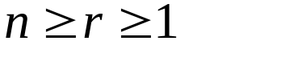
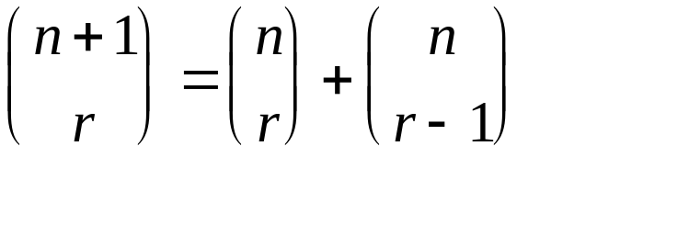
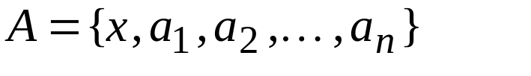
Chapter 3 Set Theory
3.1 Sets and Subsets
Ex. 3.11 For integer n, r with
prove
combinatorially.
Let
Consider all subsets of A that contain r elements.
those include r
all possibilities
those exclude r

Slide 10
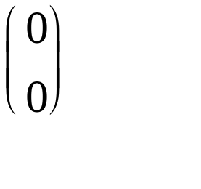
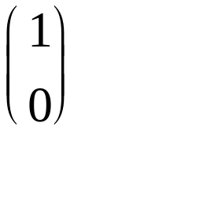
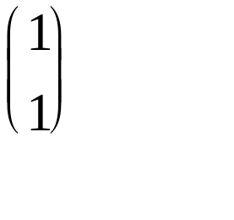
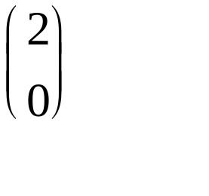
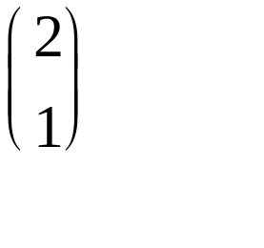

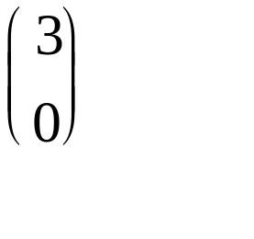
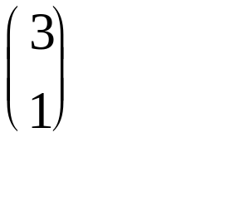
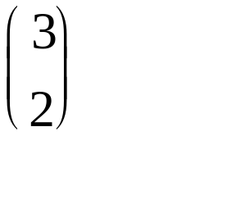
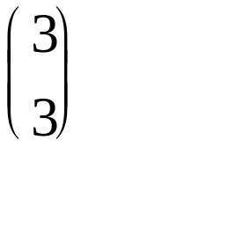
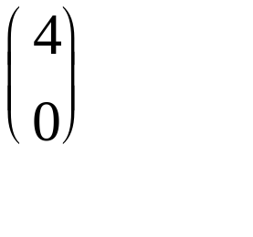


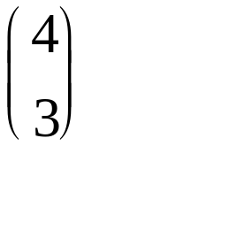

Chapter 3 Set Theory
3.1 Sets and Subsets
Ex. 3.13 The Pascal's Triangle
binomial
coefficients

Slide 11
Chapter 3 Set Theory
3.1 Sets and Subsets
common notations
(a) Z=the set of integers={0,1,-1,2,-1,3,-3,...}
(b) N=the set of nonnegative integers or natural numbers
(c) Z⁺=the set of positive integers
(d) Q=the set of rational numbers={a/b| a,b is integer, b not zero}
(e) Q⁺=the set of positive rational numbers
(f) Q*=the set of nonzero rational numbers
(g) R=the set of real numbers
(h) R⁺=the set of positive real numbers
(i) R*=the set of nonzero real numbers
(j) C=the set of complex numbers

Slide 12
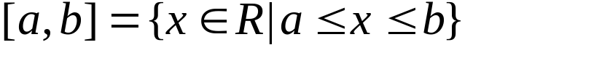
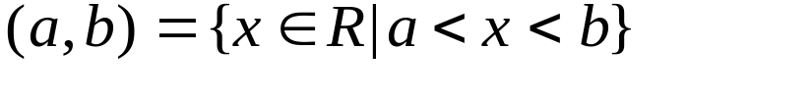
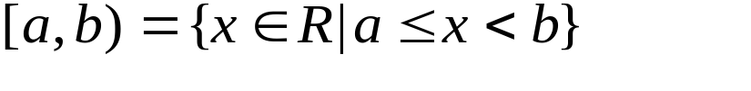
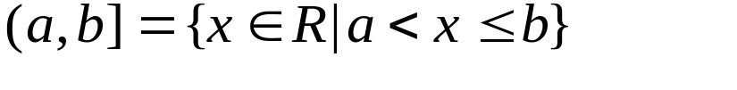
Chapter 3 Set Theory
3.1 Sets and Subsets
common notations
(k) C*=the set of nonzero complex numbers
(l) For any n in Z⁺, Z_{n}={0,1,2,3,...,n-1}
(m) For real numbers a,b with a<b,
closed interval
open interval
half-open interval

Slide 13
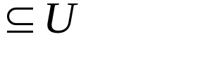
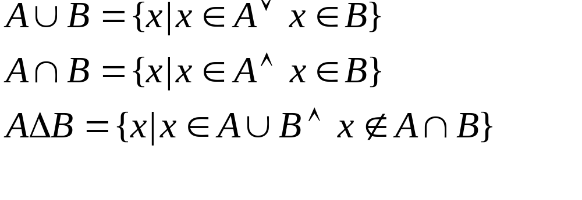
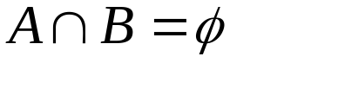
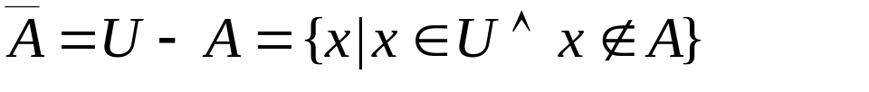
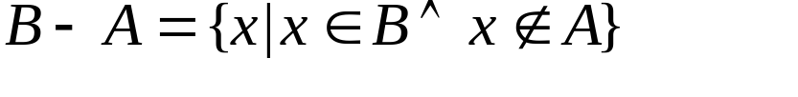
Chapter 3 Set Theory
3.2 Set Operations and the Laws of Set Theory
Def. 3.5 For A,B
a)
union
b)
intersection
c)
symmetric difference
Def.3.6 mutually disjoint
Def 3.7 complement
Def 3.8 relative complement of A in B

Slide 14
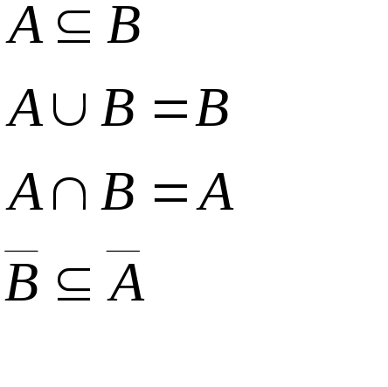
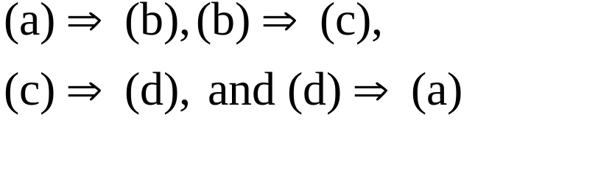
Chapter 3 Set Theory
3.2 Set Operations and the Laws of Set Theory
Theorem 3.4 For any universe U and any set A,B in U, the
following statements are equivalent:
a)
b)
reasoning process
c)
d)

Slide 15
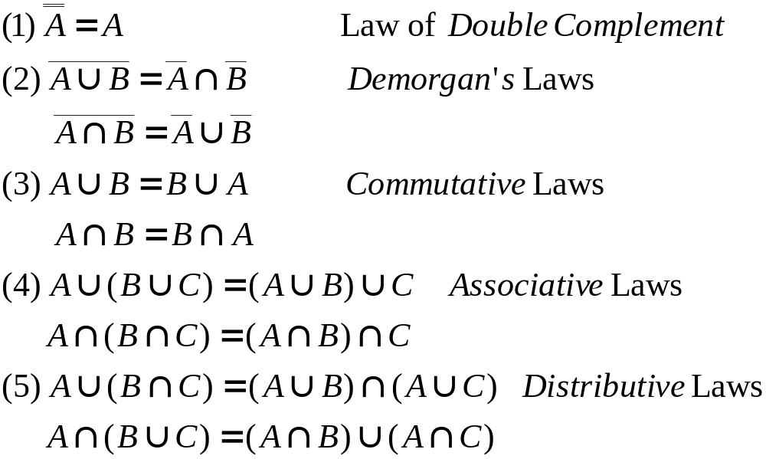
Chapter 3 Set Theory
3.2 Set Operations and the Laws of Set Theory
The Laws of Set Theory

Slide 16
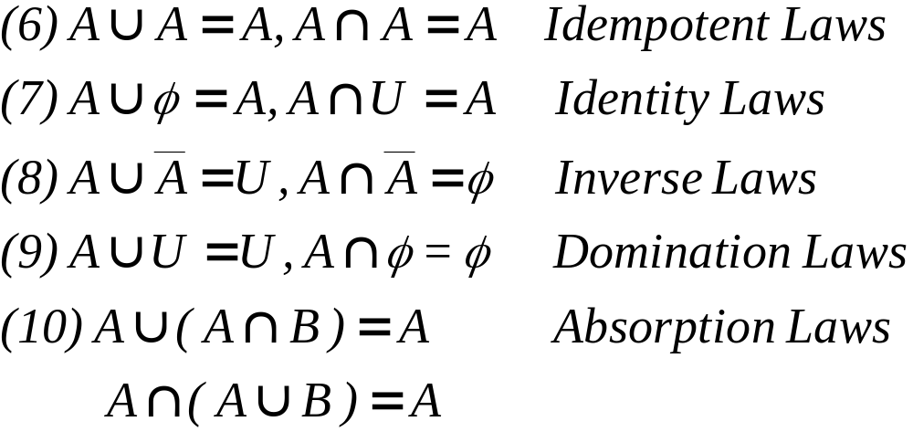
Chapter 3 Set Theory
3.2 Set Operations and the Laws of Set Theory
The Laws of Set Theory

Slide 17
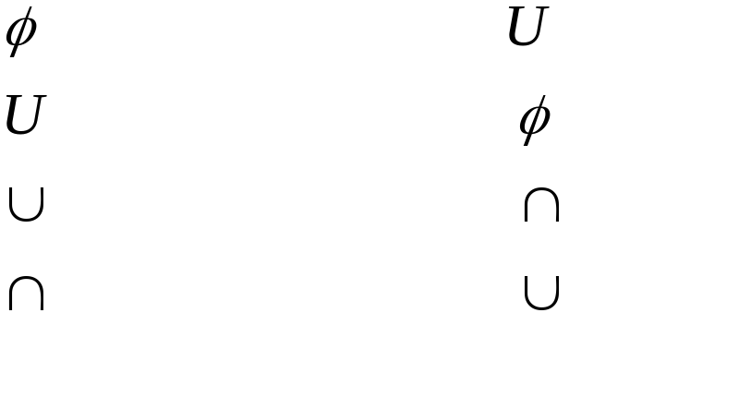
Chapter 3 Set Theory
3.2 Set Operations and the Laws of Set Theory
s dual of s (s^{d})
Theorem 3.5 (The Principle of Duality) Let s denote a theorem
dealing with the equality of two set expressions. Then s^{d} is also
a theorem.

Slide 18
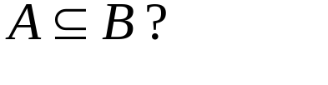
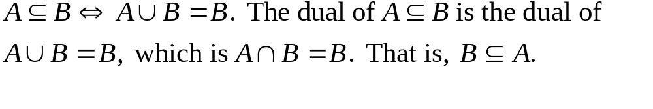

Chapter 3 Set Theory
3.2 Set Operations and the Laws of Set Theory
Ex. 3.17 What is the dual of
Since
Venn diagram
U
A
A
A
B

Slide 19
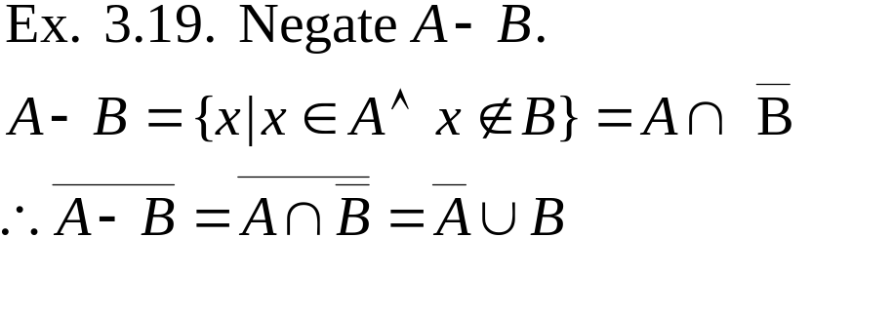
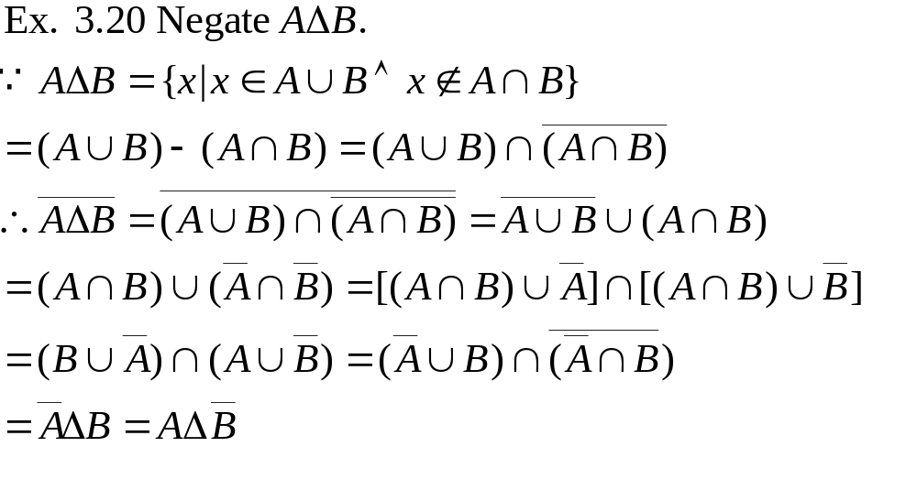
Chapter 3 Set Theory
3.2 Set Operations and the Laws of Set Theory

Slide 20
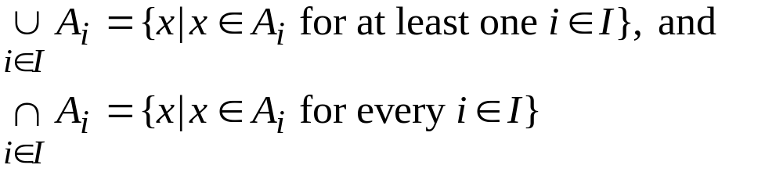
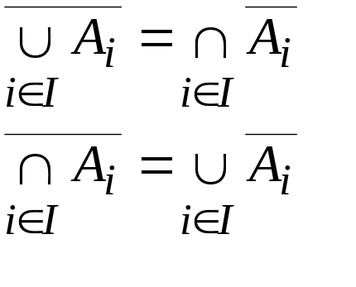
Chapter 3 Set Theory
3.2 Set Operations and the Laws of Set Theory
Def 3.10.
I: index set
Theorem 3.6 Generalized DeMorgan's Laws

Slide 21

Chapter 3 Set Theory
3.3 Counting and Venn Diagrams
Ex. 3.23. In a class of 50 college freshmen, 30 are studying
BASIC, 25 studying PASCAL, and 10 are studying both. How
many freshmen are studying either computer language?
U
5
A
B
20
10
15

Slide 22
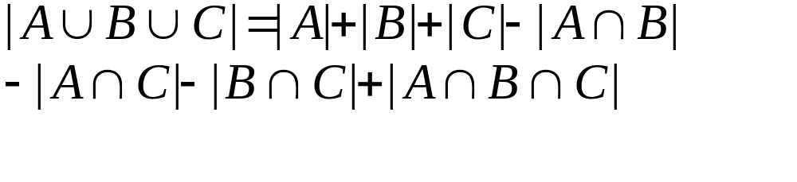
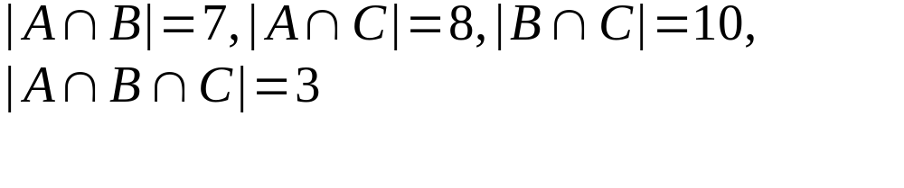
Chapter 3 Set Theory
3.3 Counting and Venn Diagrams
Ex 3.24. Defect types of an AND gate:
D₁: first input stuck at 0
D₂: second input stuck at 0
D₃: output stuck at 1
B
12
11
4
43
3
7
5
A
15
C
Given 100 samples
set A: with D₁
set B: with D₂
set C: with D₃
with |A|=23, |B|=26, |C|=30,
, how many samples have defects?
Ans:57

Slide 23
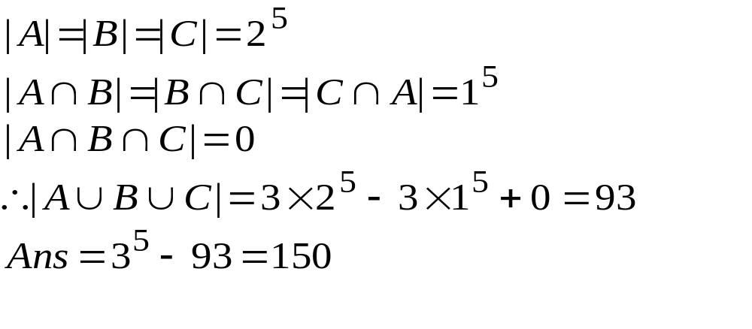
Chapter 3 Set Theory
3.3 Counting and Venn Diagrams
Ex 3.25
There are 3 games. In how many ways can one play
one game each day so that one can play each of the
three at least once during 5 days?
set A: without playing game 1
set B: without playing game 2
set C: without playing game 3
balls containers
1
2
3
4
5
g1
g2
g3

Slide 24
Chapter 3 Set Theory
3.4 A Word on Probability
event A
a
elementary event
U=sample space
Pr(A)=the probability that A occurs=|A|/|U|
Pr(a)=|{a}|/|U|=1/|U|

Slide 25
Chapter 3 Set Theory
3.4 A Word on Probability
Ex. 3.27 If one tosses a coin four times, what is the probability
of getting two heads and two tails?
Ans: sample space size=2⁴=16
Supplementary
Exercise:
4, 18
event: H,H,T,T in any order, 4!/(2!2!)=6
Consequently, Pr(A)=6/16=3/8
Each toss is independent of the outcome of any previous toss.
Such an occurrence is called a Bernoulli trial.

